Slide 1
CSE461 Project Presentation
Automatic Seed Sowing Robot
Section 09, Spring 2024
Group 3
Group Members:
Al-shahriar Redoy 21301348
Mugdha Saha 21301645
Md Maruf 21301724
Aminul Islam 23341055
MD. Shihab Sarar-21301298

Slide 2
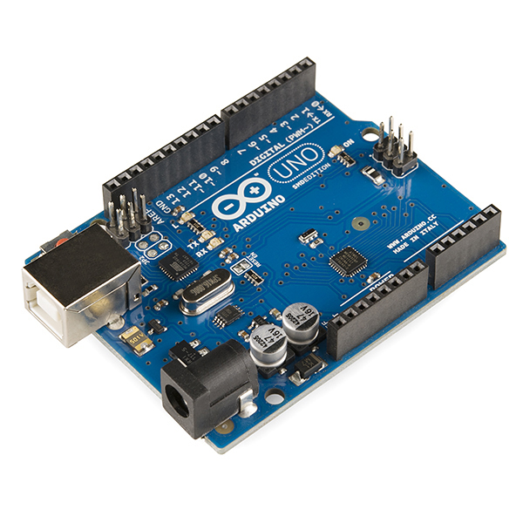
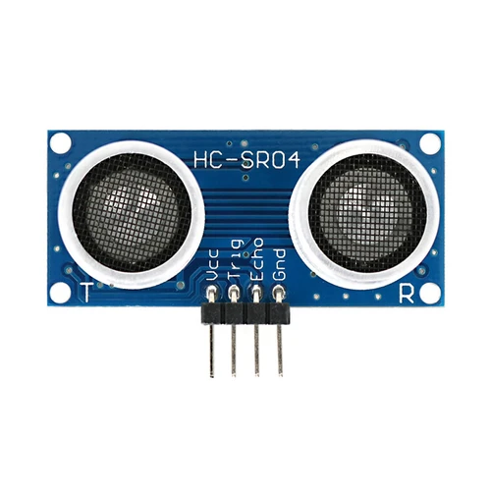
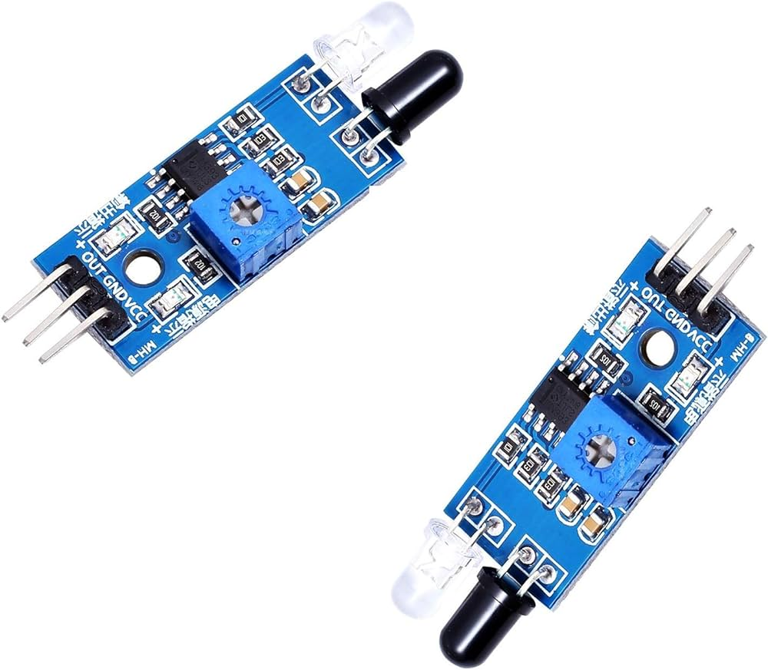
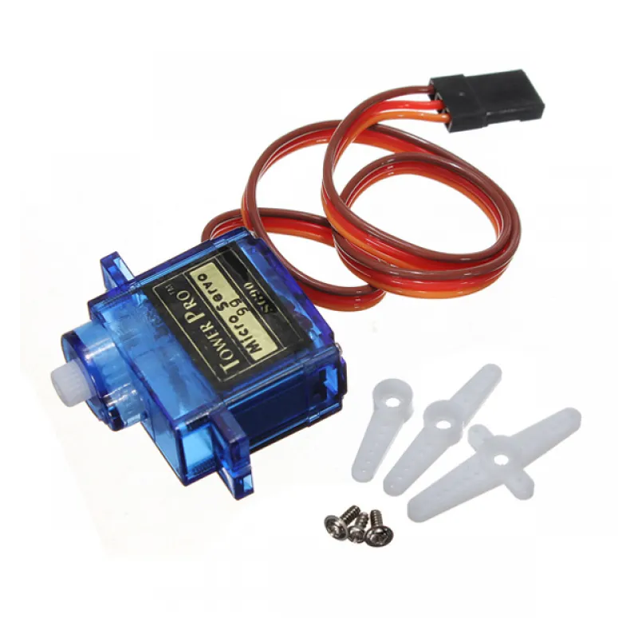
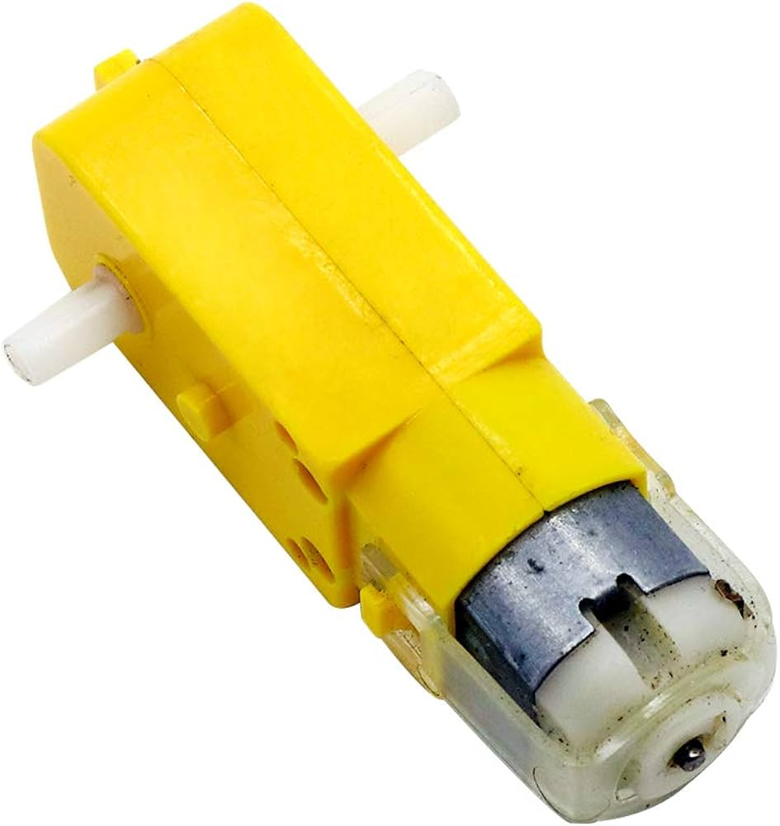
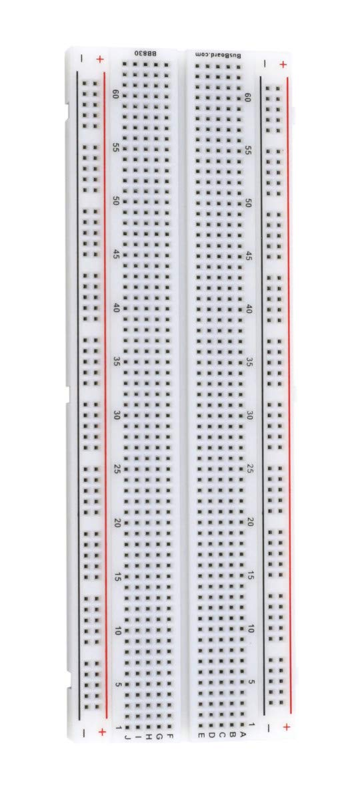
Components:
● Arduino
● IR Sensor
● Ultrasonic sensor
● DC motor
● Servo motor
● Breadboard
● Water Pump
● Motor Driver module
● Wire

Slide 3
Price Breakdown:
● Arduino (850 tk)
● IR sensor (2*45 = 90 tk)
● Ultrasonic sensor (100 tk)
● DC motor (4*80= 320 tk)
● Servo motor (150 tk)
● Breadboard (85 tk)
● 6v Dc motor (100 tk)
● Motor Driver module (250 tk)
● wire (50 tk) ●
6v Water Pump ( 80 tk )

Slide 4
Purpose of this Robot
An automatic seed sowing and spraying robot is a multifunctional device designed to streamline agricultural tasks. Its main purposes are:
1. Reduce manual labour
2. Increase efficiency and productivity
3. Improve precision and accuracy
4. Reduce strain and injuries

Slide 5
Functionality Breakdown
This robot will take in the category of a seed and calculate the distance needed between two seeds based on the growth of the plant :
Obstacle detection
Seed Sowing System
Spraying System

Slide 6
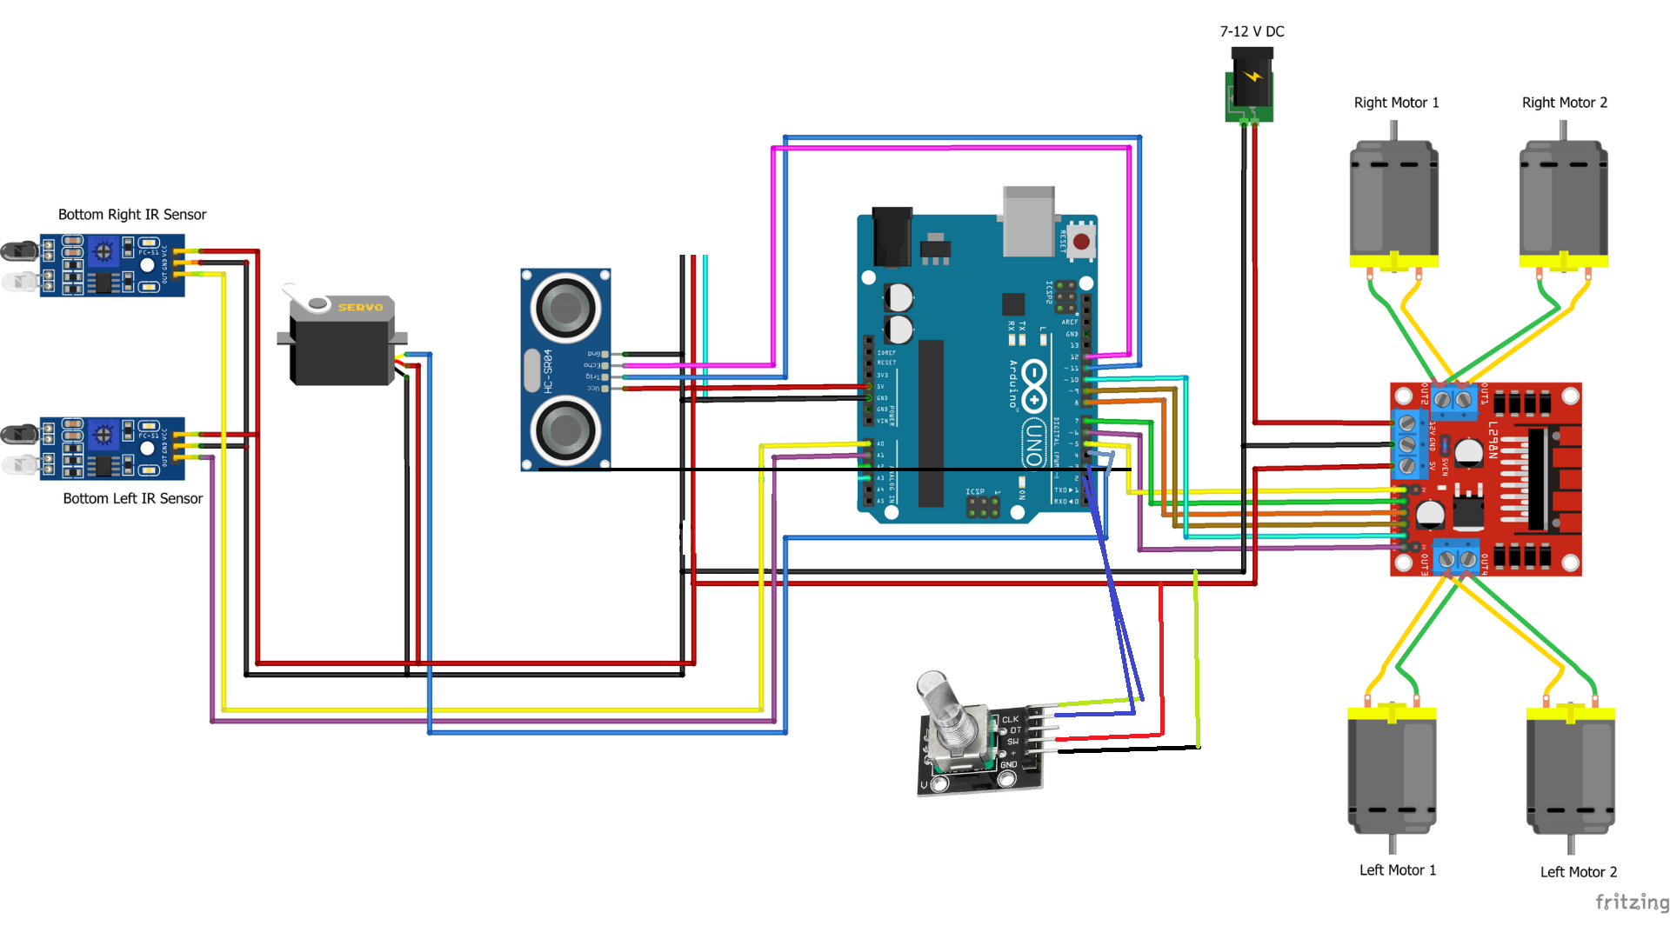
Central Control System

Slide 7
Potential Challenges
Automatic seed sowing and spraying robots offer a range of potential benefits, but they also come with their own set of challenges:
High Initial Cost
Technical Complexity
Reliance on Technology
Limited Versatility
Environmental Factors
Data Security and Privacy

Slide 8
Thank You

